Slide 1
Adventure Works Sales Analysis Project
Group 6
Rahul Vishnu Shewale 2) Madamanchi Bharath
3) Aasheesh Dashore 4) Kirankumar Mudhol
5) D Yuva Kiran 6) Rakesh A P
7) Nallanagula Adharsh

Slide 2
AGENDA
Introduction
Data Overview
KPI Analysis
Dashboard Analysis • Power BI Dashboard • Tableau Dashboard • Excel Dashboard
Key Insights
Recommendations
Conclusion

Slide 3
INTRODUCTION
The Adventure Works Sales Analysis project focuses on analyzing historical sales data to understand business performance, customer behavior, and product trends.
This project leverages Business Intelligence tools such as Power BI, Tableau, and Excel to transform raw data into interactive dashboards and meaningful insights.
The main objective is to support data-driven decision-making by identifying key performance indicators (KPIs), sales patterns, and growth opportunities.

Slide 4
DATA OVERVIEW
The Adventure Works dataset is a structured business dataset that contains detailed information about sales transactions, customers, products, and regional performance.
🔹 Dataset Categories:
📦• Product Data Includes Product Name, Category, and Sub-category, which helps analyze product performance and identify best-selling items.
👤• Customer Data Contains Customer Names and segmentation details, useful for understanding purchasing behavior and identifying top customers.
💰• Sales & Financial Data Includes Sales Amount, Profit, and Production Cost, which are essential for evaluating business profitability and financial performance.
📅• Time-Based Data Includes Year, Quarter, and Month, enabling trend analysis and seasonal performance tracking.
📍• Geographical Data Includes Region and Country, helping to analyze sales distribution across different locations.

Slide 5
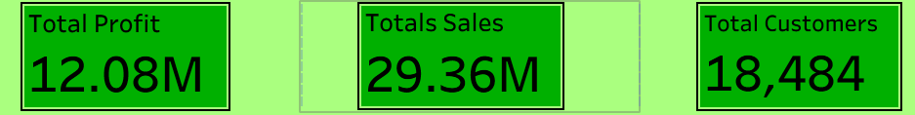
KEY PERFORMANCE INDICATORS (KPIs)
Key Performance Indicators (KPIs) provide a quick summary of overall business performance and help in monitoring growth and efficiency.
🔹 Total Sales: 29.36M Represents the total revenue generated from all products and regions. It indicates the overall business scale and market performance.
🔹 Total Profit: 12.08M Shows the net earnings after deducting production costs. A higher profit indicates strong financial performance and efficient cost management.
🔹 Total Customers: 18,484 Represents the total number of unique customers. It helps in understanding customer reach and business expansion.
🔹 KPI Importance: • Helps in quick decision-making • Provides a high-level performance summary • Acts as a benchmark for business growth

Slide 6
POWER BI DASHBOARD ANALYSIS
The Power BI dashboard provides an interactive, visually rich representation of sales data, helping identify trends, patterns, and performance metrics.
🔹 KPI Overview The dashboard highlights key metrics such as Total Sales (29.36M), Total Profit (12.08M), and Total Customers (18.48K), giving a quick summary of business performance.
🔹 Sales by Region Australia is the top-performing region, followed by Southwest and Northwest, indicating strong market presence in these areas.
🔹 Year-wise Sales Analysis The year 2013 shows the highest sales, reflecting peak business growth during this period.
🔹 Month-wise Sales Trend Sales show a declining trend from December to February, indicating possible seasonal variation.
🔹 Quarter-wise Sales Distribution Q4 contributes the highest percentage (~31%), followed by Q3 and Q2, showing strong end-of-year performance.
🔹 Sales vs Production Cost The comparison shows that although production cost increases, sales remain significantly higher, ensuring profitability.
🔹 Product-wise Sales A few products contribute the majority of sales, indicating high demand for specific items.

Slide 7
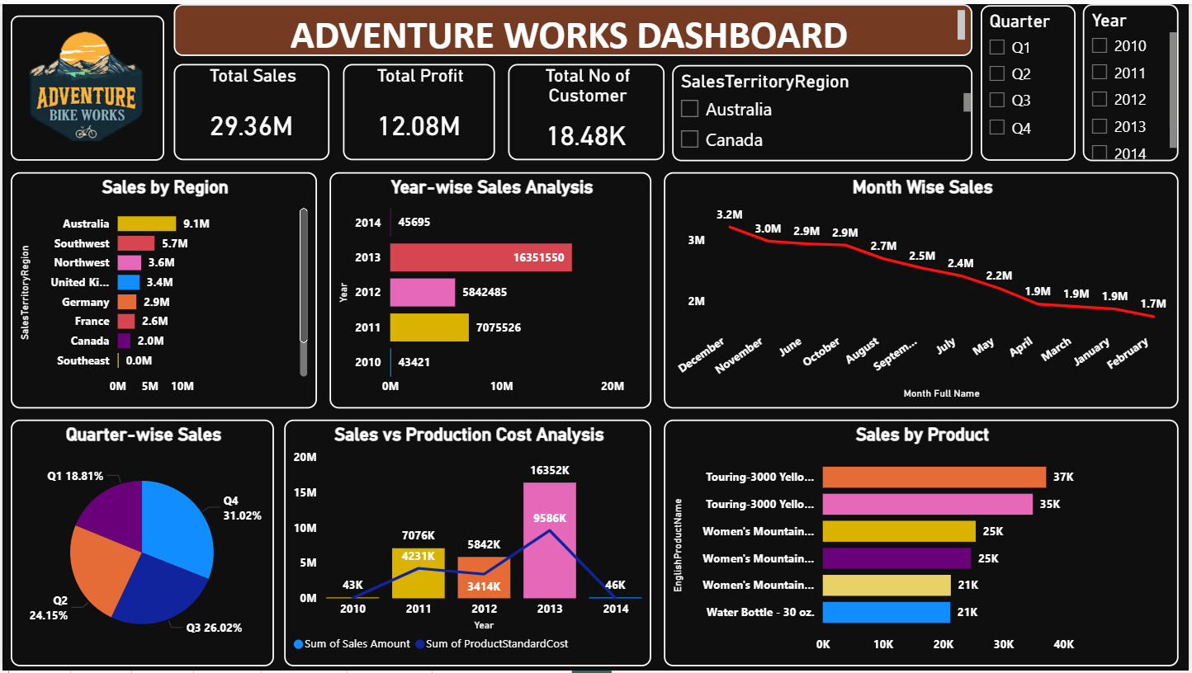
POWER BI DASHBOARD

Slide 8
TABLEAU DASHBOARD ANALYSIS
The Tableau dashboard provides an interactive and visually appealing representation of sales data, focusing on trend analysis and comparative insights.
🔹 KPI Overview The dashboard highlights key metrics such as Total Sales, Total Profit, and Total Customers, providing a quick summary of business performance.
🔹 Year-wise Sales Trend The sales trend shows a steady increase over the years, with 2013 being the highest-performing year, indicating business growth.
🔹 Quarter-wise Analysis Among all quarters, Q4 contributes the highest sales, showing strong year-end performance.
🔹 Month-wise Sales Trend Sales fluctuate across months, with noticeable peaks during certain months, reflecting seasonal demand patterns.
🔹 Region-wise Sales Distribution Regions such as Australia and the Southwest contribute the most to total sales, highlighting key business markets.
🔹 Customer-wise Sales Contribution A small number of customers contribute significantly to overall revenue, indicating high-value customer segments.
🔹 Interactive Filters Filters such as Year and Region allow dynamic and customized analysis of the data.

Slide 9
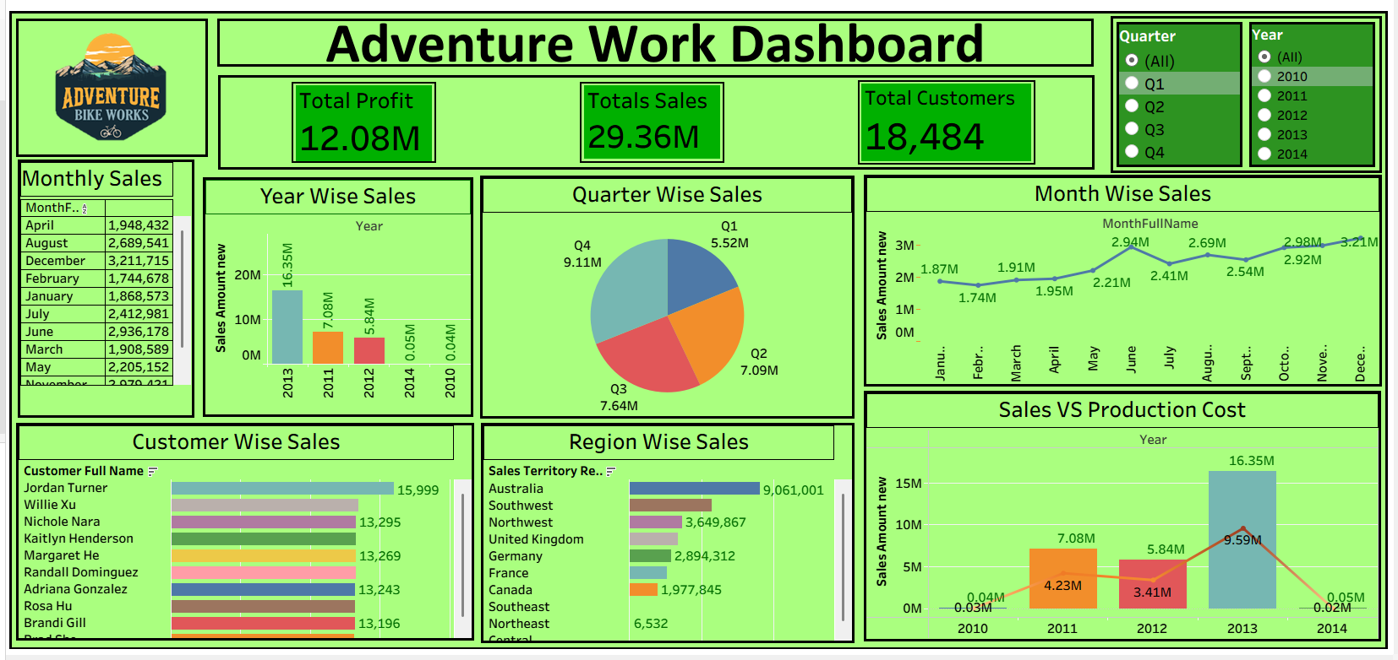
Tableau Dashboard

Slide 10
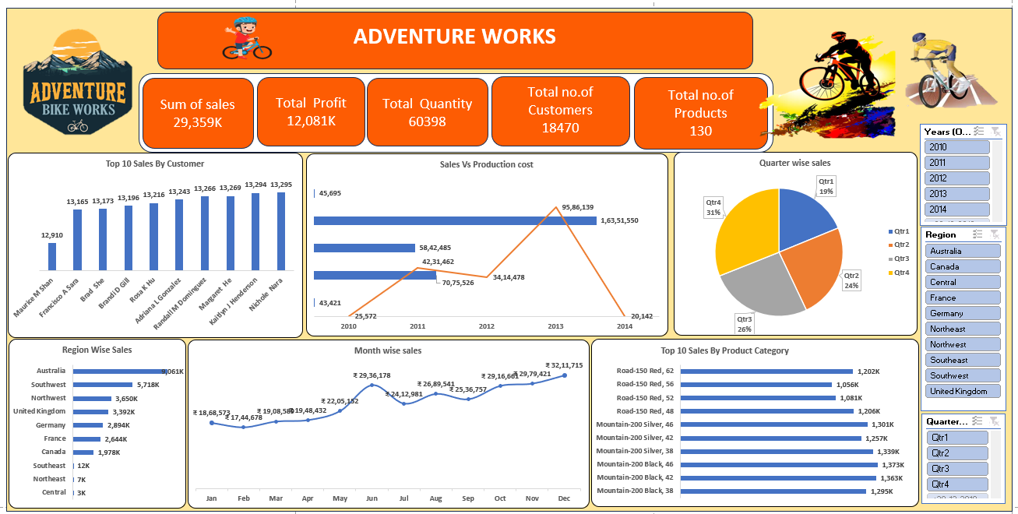
Excel Dashboard

Slide 11
KEY INSIGHTS
Based on the analysis of dashboards created using Power BI, Tableau, and Excel, the following key insights were identified:
📈🔹Peak Sales Year The year 2013 recorded the highest sales, indicating strong business growth during this period.
📅🔹 Quarterly Performance Q4 contributes the highest share of total sales, showing that end-of-year demand is significantly higher.
📈🔹 Seasonal Sales Trends Sales show fluctuations across months, with higher sales in specific months, indicating seasonal demand patterns.
🌍🔹 Top Performing Regions Regions such as Australia and the Southwest generate the highest revenue, making them key business markets.
👥🔹 Customer Contribution A small group of customers contributes a large portion of total sales, highlighting the importance of high-value customers.
📦 🔹 Product Performance A limited number of products dominate overall sales, indicating high demand for specific products.
💰🔹 Profitability Insight Sales consistently exceed production costs, ensuring overall business profitability.

Slide 12
RECOMMENDATIONS
Based on the insights derived from the data analysis, the following recommendations are proposed:
🔹 Focus on High-Performing Regions 🌍 Increase marketing efforts and investment in regions like Australia and the Southwest to maximize revenue growth.
🔹 Improve Low-Performing Regions 📉 Identify challenges in underperforming regions and implement targeted strategies to boost sales.
🔹 Promote Top-Selling Products 📦 Focus on high-demand products through promotions, discounts, and better availability.
🔹 Customer Retention Strategies 👥 Develop loyalty programs and personalized offers to retain high-value customers.
🔹 Seasonal Marketing Strategy 📅 Leverage peak seasons (especially Q4) by planning campaigns, offers, and inventory accordingly.
🔹 Cost Optimization 💰 Monitor and control production costs to further increase profit margins.
🔹 Data-Driven Decision Making 📊 Use insights from dashboards regularly to improve business strategies and performance.

Slide 13
CONCLUSION
The Adventure Works Sales Analysis project demonstrates how raw data can be transformed into meaningful insights using Business Intelligence tools such as Power BI, Tableau, and Excel.
Through detailed analysis, key trends related to sales performance, customer behavior, regional contribution, and product demand were identified.
The project highlights that: 📊• Data visualization helps in a better understanding of business performance 💡• Identifying trends and patterns supports strategic decision-making 🌍 • High-performing regions and products drive major revenue 📈• Seasonal trends play a significant role in sales growth
Overall, this project emphasizes the importance of data-driven decision-making in improving business efficiency, profitability, and growth.

Slide 14
Thank You

